Slide 1






Trading social status for genetics in marriage markets: Evidence from UK Biobank
Abdel Abdellaoui (Amsterdam UMC) Oana Borcan (UEA) Pierre Chiappori (Columbia) David Hugh-Jones (UEA)
RES 2022

Slide 2
Goals of this paper
In increasing order of ambition:
Explain a puzzle about the intergenerational persistence of inequality.
Provide a new explanation of the genes-SES (socio-economic status) gradient.
Rethink the nature of inequality in historical human societies.
Change how we think about genetic variation.

Slide 3
Inequality persists surprisingly over generations (Clark and Simmons 2015; Solon 2018).
Families are relevant: wealth, human capital and other traits are passed from parents to children.
Inherited human genetics help to explain inequality:
Heritability of occupational class and educational attainment is about 50% (Tambs et al. 1989)
Family SES of 2-year-olds can be predicted from their genes (Trzaskowski et al. 2014)
Polygenic scores for educational attainment predict occupational class (Rimfeld et al. 2018)
Unobserved genetic variation could explain the high persistence of SES in families over time (Clark and Simmons 2015; Clark 2021)
The leading explanation for the genes-SES gradient is meritocracy: “good genes” lead to upward mobility.

Slide 4
We offer a new explanation for the genes-SES gradient, based on assortative mating (Fernandez and Rogerson 2000; Fernandez et al. 2005; Schwartz and Mare 2005; Greenwood et al. 2014; Eika et al. 2019).
Under social-genetic assortative mating (SGAM), SES and “good” genes both contribute to attractiveness in marriage markets.
Both are inherited.
As a result, SES and genetics become associated in the next generation.
Consequently:
Shocks to SES are reflected in children’s genetics.
Unobserved genetics may explain persistence of wealth, but as a mediator not a confound.
The genes-SES gradient is likely historically widespread, beyond modern meritocracies.
We test this theory using data from the UK Biobank.

Slide 5

Model
Traits $x_{1}$ (genetic) and $x_{2}$ (SES) are normally distributed in the population.
Attractiveness is $ax_{1}+(1−a)x_{2}$ where $0≤a≤1$ is the relative importance of genes.
People mate assortatively.
Children inherit
$${x′}_{1}=\frac{τ}{2}\left(x_{1}+y_{1}\right)+ε$$
$$x_{2}^{′}=\frac{θ}{2}\left(x_{2}+y_{2}\right)+η$$
Where:
$τ$ is close to 1 (genetic inheritance).
$θ$ reflects persistence of SES (e.g. tax rate $1−θ$).

Slide 6
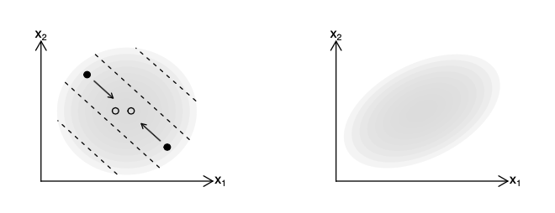
Intuition
Parents
Children
Parents (●) mate along iso-attractiveness curves.
Their children (○) are between them.
As a result, the children’s distribution is squashed along the attractiveness gradient.

Slide 7
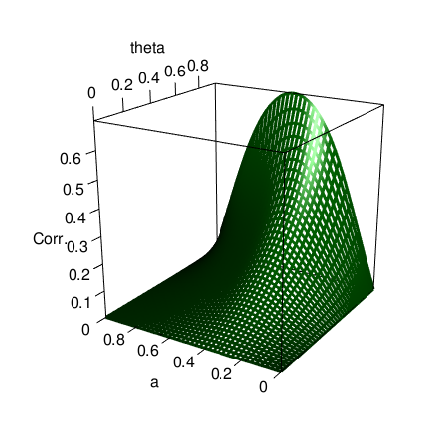

Result
If parents’ $x_{1}$ and $x_{2}$ are independent, children’s ${x′}_{1}$ and ${x′}_{2}$ are positively correlated for $0<a<1$. The correlation increases in $θ$.
The same holds for the long-run distribution.
Extensions
Long-run correlation between $x_{1}$ and $x_{2}$, by $a$ and $θ$

Slide 8
Data
UK Biobank, a study of about 500,000 individuals born 1935-1970. Questionnaire data on health and social characteristics, also DNA. Non-representative!
No explicit information on spouse pairs.
We categorize people as pairs if they:
• had the same home postcode;
• have the same homeownership/renting status, length of time at the address, and number of children;
• attended the same UK Biobank assessment centre on the same day;
• both reported living with their spouse (“husband, wife or partner”);
• consisted of one male and one female.
We validate pairs using genetic children, also in the database.

Slide 9
Our dependent variable is spouse’s Polygenic Score for Educational Attainment (PSEA).
This is a DNA-derived summary statistic which predicts people’s level of educational attainment.
Polygenic scores

Slide 10
Polygenic Score for Educational Attainment
Linear regression of probability of attending university on PSEA: 1 sd PSEA = 9.2 percentage points.
Within-siblings regression (causal): 4.5 percentage points.
👉 Substantial confounding with family environment, but large causal effects.
University attendance by PSEA decile

Slide 11
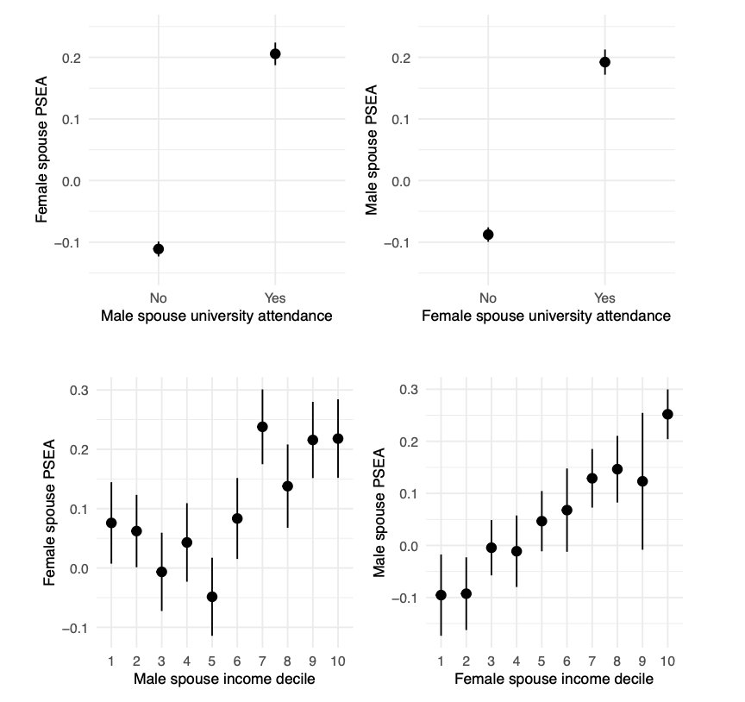

Slide 12
These results could be confounded by the individual’s own genetics.
We already know that there is assortative mating on PSEA (Hugh-Jones et al. 2016).
We need an independent variable which is
independent of genetics;
available for a large enough N.
Polygenic scores and causes of variation in SES are noisy
The spouse matching process is unpredictable (Shakespeare 1595)
We use birth order.
Siblings have the same expected polygenic scores, by the “lottery of meiosis”.
Early-born siblings receive more parental care and have better life outcomes, including socio-economic status (SES).

Slide 13
Estimation strategy
Hard to justify instrumental variables:
Birth order affects other things than SES.
We only have imperfect measures of SES (rough household income, job, educational attainment).
Instead we run a mediation analysis:
Does birth order affect spouse’s PSEA?
Is the effect mediated by measures of SES?

Slide 14
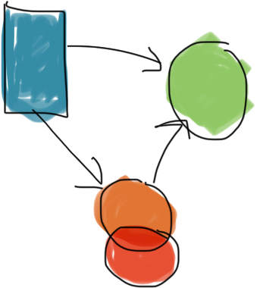



Estimation strategy
Hard to justify instrumental variables:
Birth order affects other things than SES.
We only have imperfect measures of SES (rough household income, job, educational attainment).
Instead we run a mediation analysis:
Does birth order affect spouse’s PSEA?
Is the effect mediated by measures of SES?
Birth order
Spouse
PSEA
SES
Mediators
Mediators
Other

Slide 15
Controls and mediators
SES mediators
University attendance
Median earnings of first job (guesstimated from SOC code)
Non-SES mediators
Fluid IQ
Height
Controls
Family size
Month of birth
Year of birth
Parent’s age at birth (correlates with birth order! Only available for some respondents)
Birth order
Spouse
PSEA
SES
Mediators
Other

Slide 16
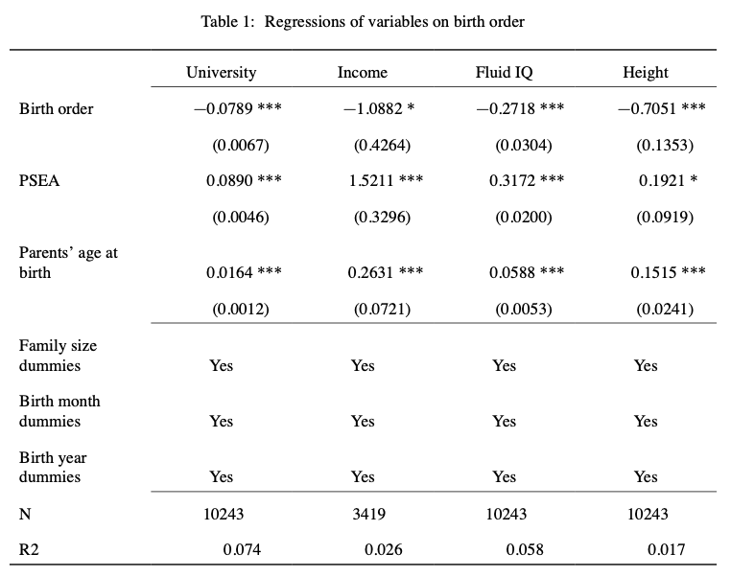


Slide 17
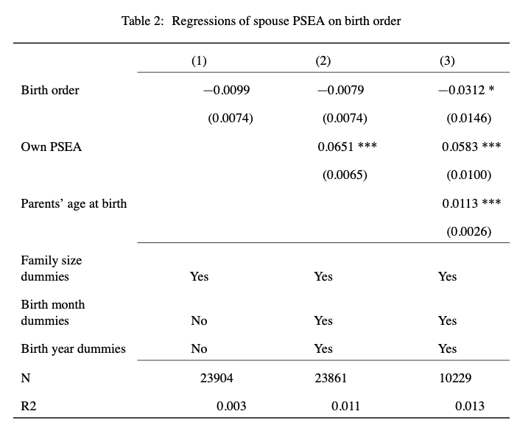



Slide 18
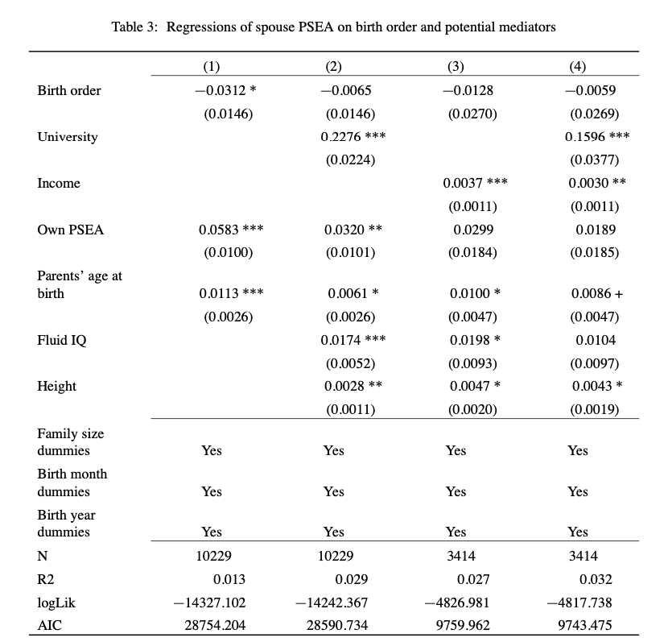
SES mediators
Non-SES mediators, controls

Slide 19
SES mediators
Non-SES mediators, controls

Slide 20
SES mediators
Non-SES mediators, controls

Slide 21
SES mediators
Non-SES mediators, controls

Slide 22
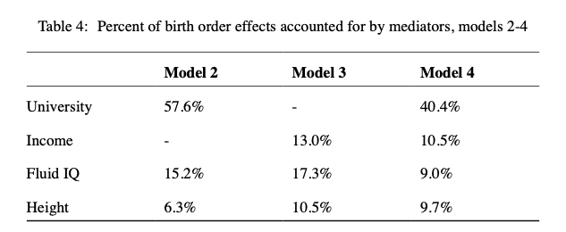
Robustness

Slide 23
Goals again
Explain a puzzle about the intergenerational persistence of inequality.
Inequality can persist because of unmeasured genetic variation (Clark 2021). Genetics can be a mediator, not just a confound, for SES.
Provide a new explanation of the genes-SES gradient.
In meritocratic societies, genes affect SES.
Under SGAM, in all societies, SES can affect genes.
Shocks to SES are reflected in the DNA of subsequent generations.
Rethink the nature of inequality in historical human societies.
Prediction: a genes-status gradient should be visible in ancient DNA.
Change how we think about genetic variation.
Yes, genes are “biological”…
But genetic variation is a social outcome.
Size of genes-SES correlation is endogenous to economic institutions θ.

Slide 24

Thank you!
“Part of the beauty of me is that I am very rich.”

Slide 25
Extensions
The basic result extends to non-normal/discontinuous distributions and non-linear attractiveness.
We can allow “meritocracy”, where adult SES depends directly on own genes.
Genes-SES correlation may either increase or decrease in θ
The a parameter can differ for men and women.
Genes-SES correlation is maximized when parameters are most different.

Slide 26
Polygenic scores – a primer
Individual DNA contains about 3 billion base pairs, on 23 chromosomes. Each base pair can be one of four letters (A, C, T or G). About 0.1% of these pairs will be different between any two individuals.
A Single Nucleotide Polymorphisms (SNPs) is a base pair where individuals’ genomes vary by a single “letter”. Individuals have 0, 1 or 2 copies of the rare allele.
DNA array data records many SNPs of an individual’s genome (in UKBB, about 500,000 SNPs).

Slide 27

Polygenic scores – a primer
Many heritable traits are highly polygenic: the sum of small effects from many loci on the genome.
A polygenic score is estimated using many SNPs. Bivariate correlations are estimated:
$$Trait_{i}=β_{j}SNP_{i,j}+ε_{i}$$
The score is then
$$PGS_{i}=\sum_{j}{β_{j}SNP_{i,j}}$$
Intuition: a PGS is like a regression $\hat{y}$ , but with “naively” estimated $β$s.
$β_{j}$ may be corrected for correlation by various methods.

Slide 28
Spouse pairs
Some respondents in the Biobank sample have a genetic child who is also in the sample.
Among our spouse pairs, 511 have a genetic child of at least one partner in the sample.
For 86% (441) of these, the child is the genetic child of both partners.
Comparison: 11% of families with dependent children included a stepchild in England and Wales in 2011 (National Statistics 2014).

Slide 29
Robustness
Extra mediators: BMI, self-reported health.
Birth order is independent of 33 different polygenic scores.
Results are qualitatively robust…
… if we use birth order dummies: strongest effect for first child versus subsequent children.
… using age left full-time education as the key mediator
… for males and females only (initial birth order coefficient is not significant)
… for couples with children

Slide 30
Bibliography
Halsey, AH. 1958. “Genetics, Social Structure and Intelligence.” British Journal of Sociology 9 (1): 15–28.
Hugh-Jones, David, Karin JH Verweij, Beate St Pourcain, and Abdel Abdellaoui. 2016. “Assortative Mating on Educational Attainment Leads to Genetic Spousal Resemblance for Polygenic Scores.” Intelligence 59: 103–8.
Hugh-Jones, David and Abdel Abdellaoui. 2022. “Human capital mediates natural selection in contemporary humans “. Working paper.
Lindahl, Lena. 2008. “Do Birth Order and Family Size Matter for Intergenerational Income Mobility? Evidence from Sweden.” Applied Economics 40 (17): 2239–57.
National Statistics. 2014. “Stepfamilies in 2011.” https://webarchive.nationalarchives.gov.uk/20160105222243/http:// www.ons.gov.uk/ons/rel/family-demography/stepfamilies/2011/stepfamilies-rpt.html.
Rimfeld, Kaili, Eva Krapohl, Maciej Trzaskowski, Jonathan R. I. Coleman, Saskia Selzam, Philip S. Dale, Tonu Esko, Andres Metspalu, and Robert Plomin. 2018. “Genetic Influence on Social Outcomes During and After the Soviet Era in Estonia.” Nature Human Behaviour 2 (4): 269–75.
Schwartz, Christine R, and Robert D Mare. 2005. “Trends in Educational Assortative Marriage from 1940 to 2003.” Demography 42 (4): 621–46.
Shakespeare, William. 1595. A Midsummer Night’s Dream.
Solon, Gary. 2018. “What Do We Know so Far about Multigenerational Mobility?” The Economic Journal 128 (612): F340–52.
Tambs, Kristian, Jon Martin Sundet, Per Magnus, and K re Berg. 1989. “Genetic and Environmental Contributions to the Covariance Between Occupational Status, Educational Attainment, and IQ: A Study of Twins.” Behavior Genetics 19 (2): 209–22.
Trzaskowski, Maciej, Nicole Harlaar, Rosalind Arden, Eva Krapohl, Kaili Rimfeld, Andrew McMillan, Philip S. Dale, and Robert Plomin. 2014. “Genetic Influence on Family Socioeconomic Status and Childrens Intelligence.” Intelligence 42 (January): 83–88
Abdellaoui, Abdel, David Hugh-Jones, Löıc Yengo, Kathryn E Kemper, Michel G Nivard, Laura Veul, Yan Holtz, et al. 2019. “Genetic Correlates of Social Stratification in Great Britain.” Nature Human Behaviour 3 (12): 1332–42.
Black, Sandra E, Paul J Devereux, and Kjell G Salvanes. 2011. “Older and Wiser? Birth Order and IQ of Young Men.” CESifo Economic Studies 57 (1): 103–20.
Booth, Alison L, and Hiau Joo Kee. 2009. “Birth Order Matters: The Effect of Family Size and Birth Order on Educational Attainment.” Journal of Population Economics 22 (2): 367–97.
Clark, Gregory. 2021. “For Whom the Bell Curve Tolls: A Lineage of 400,000 English Individuals 1750-2020 Shows Genetics Determines Most Social Outcomes.” Working Paper. http://faculty.econ.ucdavis.edu/faculty/ gclark/ClarkGlasgow2021.pdf.
Clark, Gregory, and Neil Cummins. 2015. “Intergenerational Wealth Mobility in England, 1858–2012: Surnames and Social Mobility.” The Economic Journal 125 (582): 61–85.
Eika, Lasse, Magne Mogstad, and Basit Zafar. 2019. “Educational Assortative Mating and Household Income In- equality.” Journal of Political Economy 127 (6): 2795–835.
Fernandez, Raquel, Nezih Guner, and John Knowles. 2005. “Love and Money: A Theoretical and Empirical Analysis of Household Sorting and Inequality.” Quarterly Journal of Economics 120 (1): 273–344.
Fernández, Raquel, and Richard Rogerson. 2001. “Sorting and Long-Run Inequality.” Quarterly Journal of Economics 116 (4): 1305–41.
Furnham, Adrian. 1993. “Just World Beliefs in Twelve Societies.” Journal of Social Psychology 133 (3): 317–29.
Gramsci, Antonio. 1971. Selections from the Prison Notebooks. Lawrence; Wishart London.
Greenwood, Jeremy, Nezih Guner, Georgi Kocharkov, and Cezar Santos. 2014. “Marry Your Like: Assortative Mating and Income Inequality.” American Economic Review 104 (5): 348–53.

